Slide 1

PCF Training – Level 0
Sesión 1
Introducción
Ángel Álvarez Valdeolmos
09/05/2019

Slide 2

Contenido
Introducción al curso
Spring Boot
Microservicios
Próximas sesiones
Entorno de desarrollo

Slide 3
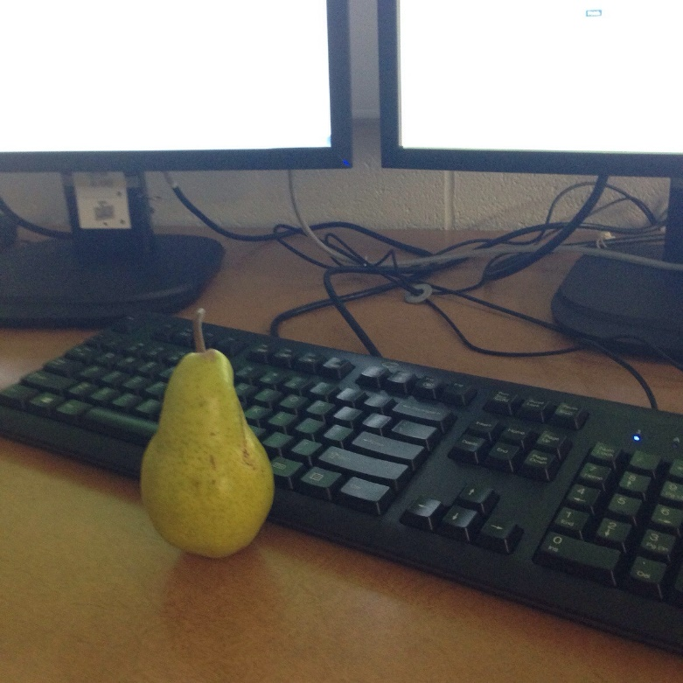
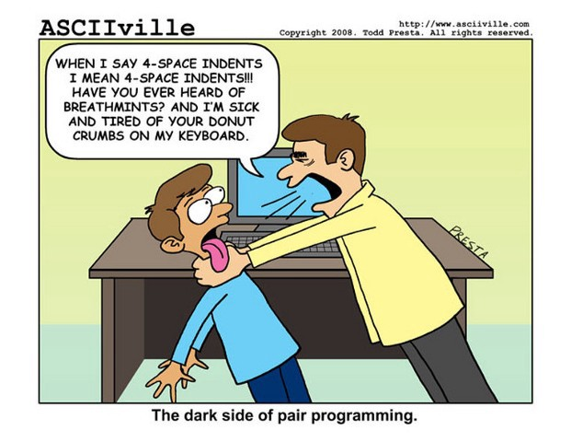
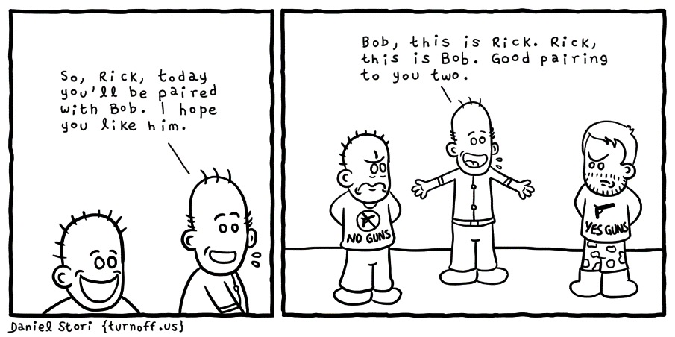
Introducción al curso
Introducción (1h.)
Sesión práctica 1 (2h.) -> Desarrollo en local
Sesión práctica 2 (2h.) -> Despliegue en la nube
Sesión práctica 3 (2h.) -> Interfaz de usuario
¿Pair Programming?

Slide 4
Spring Boot

Slide 5
Spring Boot
Framework basado en Spring
Mínima configuración
No sólo para “PCF”
Contexto para configuración, código para negocio
Programación Funcional/declarativa vs imperativa
Basado en dependencias

Slide 6

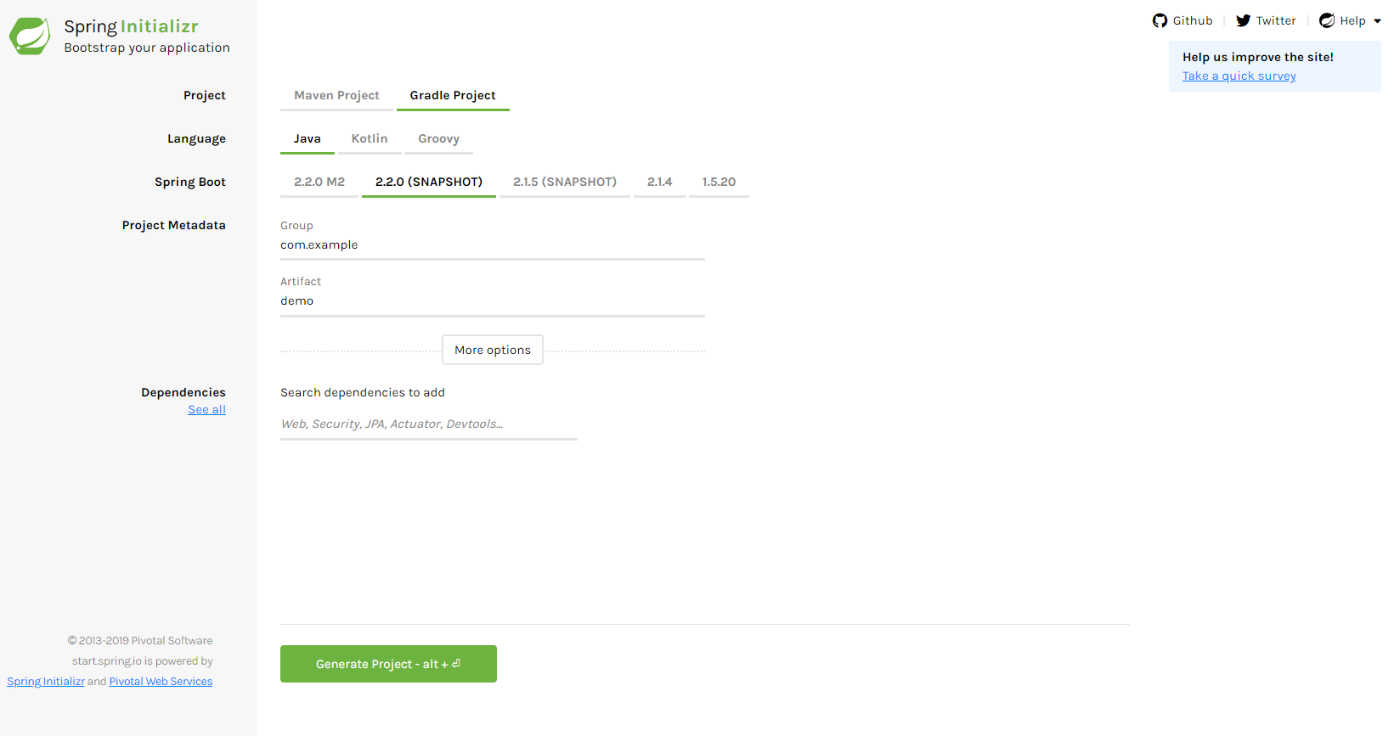
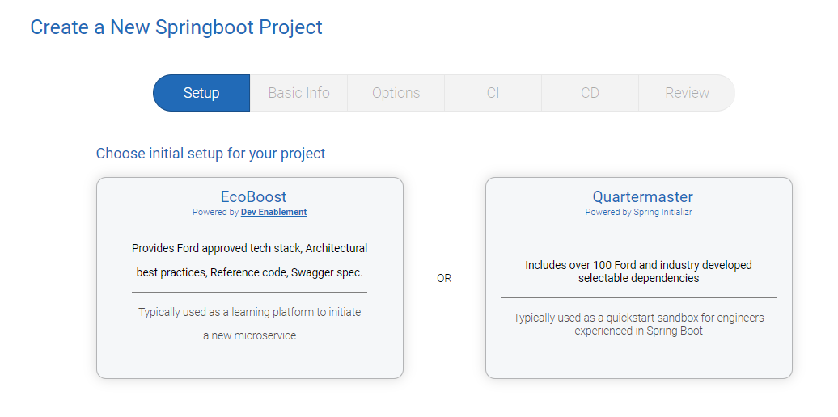
Initializr
Oficial de Spring: https://start.spring.io/
Spring initializr
Ford https://dcs.apps-pcf04v2i.cf.ford.com/project-workflow/springboot
Ecoboost: “Ford friendly”
Quartermaster: Basado en Spring Initializr + Ford Dependencies

Slide 7
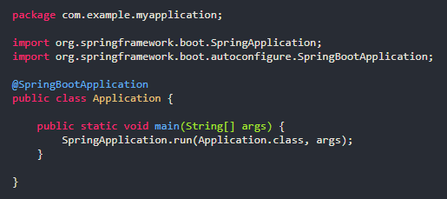
Spring Boot - Main

Slide 8
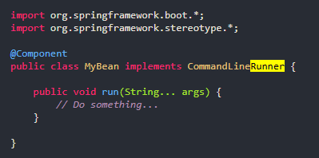
Aplication/Command Runners

Slide 9
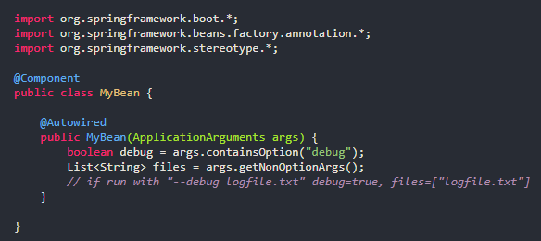
Spring Boot – Dependeny Injection

Slide 10

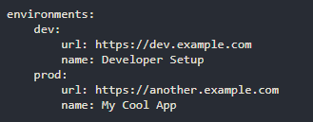
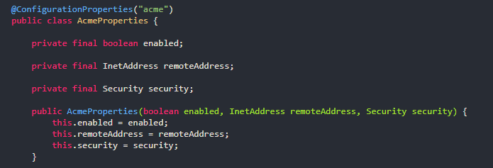
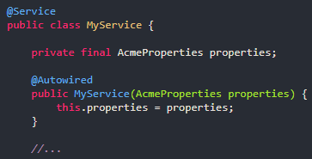
Spring Boot – Properties

Slide 11
Microservices

Slide 12
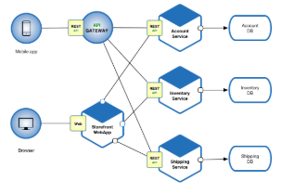
Microservices
Highly maintainable and testable
No micro size
Loosely coupled
Independently deployable
Organized around business capabilities.
Developed By a Small Team (80% working independently)

Slide 13
Patterns
Decomposition
Business capability
Subdomain
Communication
Style (Remote procedure invocation, Messaging, Domain-specific)
External API (API gateway, Backend for front-end)
Service Discovery
Reliability (Circuit Breaker)
Data Management
Saga
CQRS
Event sourcing
Database per service
…

Slide 14
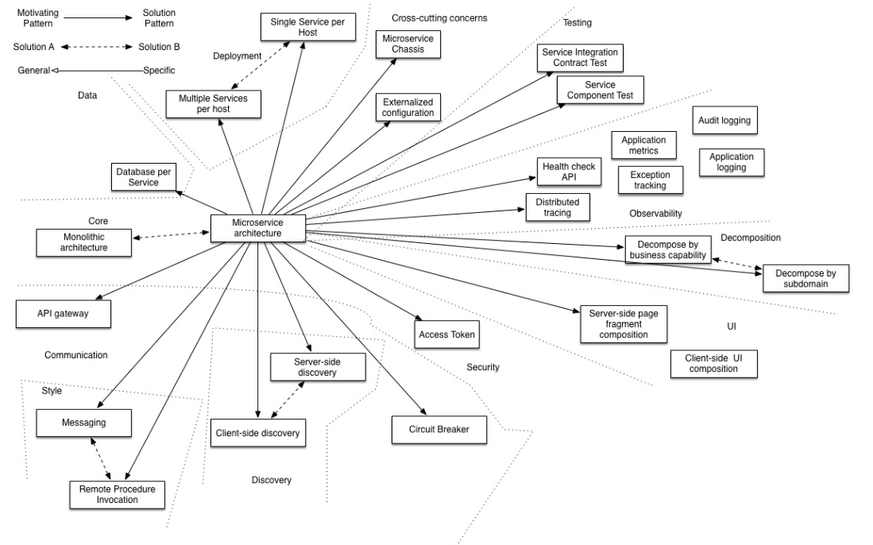
Microservice related patterns

Slide 15
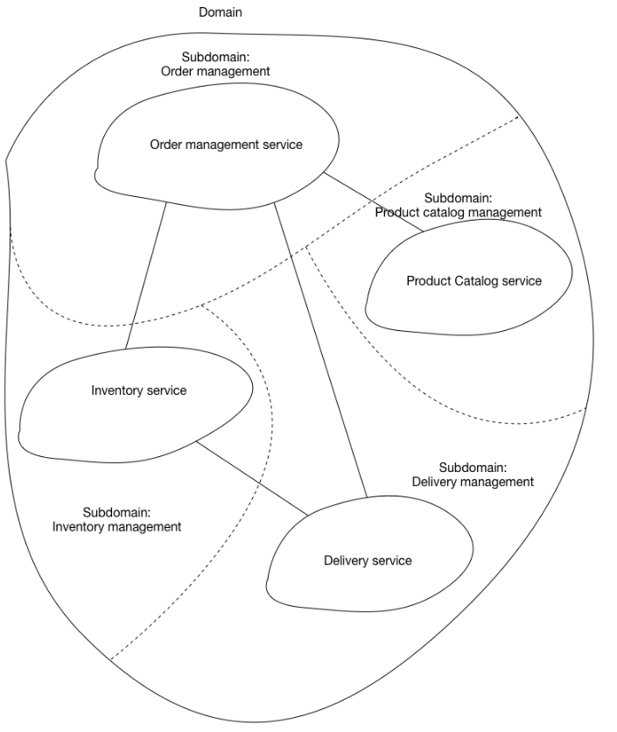
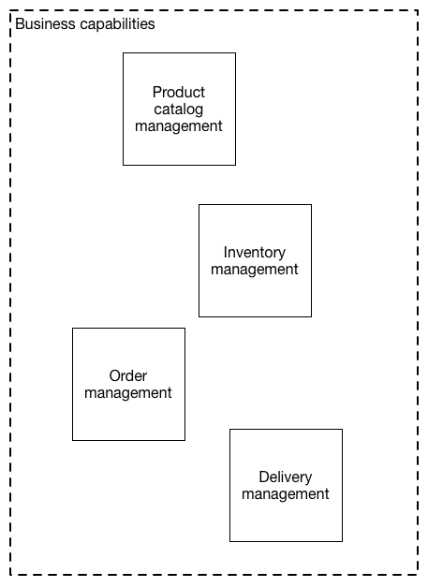
Decomposition

Slide 16
Communication (Styles)
Remote Procedure Invocation (RPI)
REST (HTTP verbs, Stateless, …)
gRPC
Apache Thrift
Messaging
RabbitMQ
Apache Kafka
Domain-specific protocol (SMTP, IMAP, RTMP, ..)

Slide 17
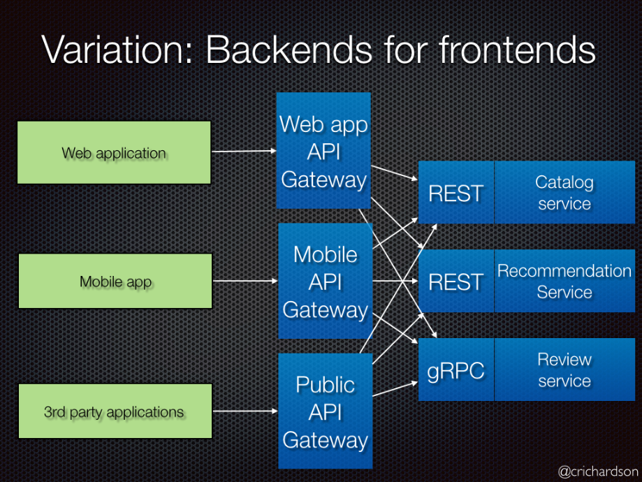
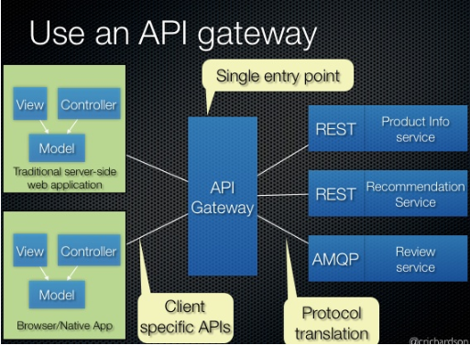
API Gateway/Front-end

Slide 18

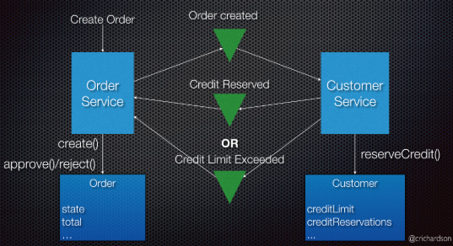
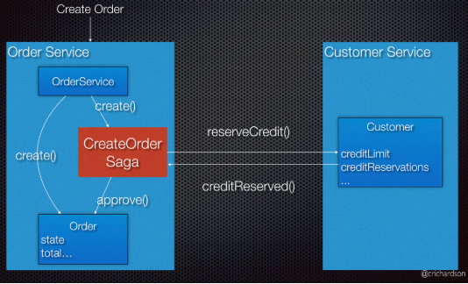
Data Managment (Database per service)
Saga

Slide 19
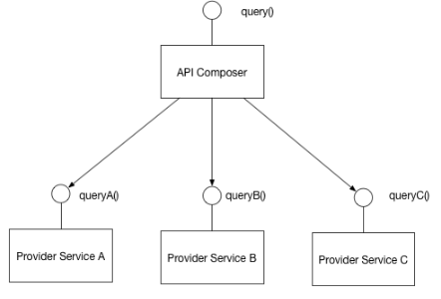
Data Managment (Database per service)
API Composition Query

Slide 20
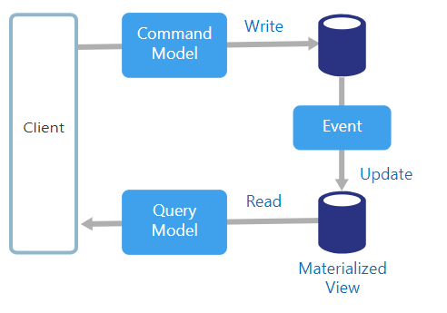
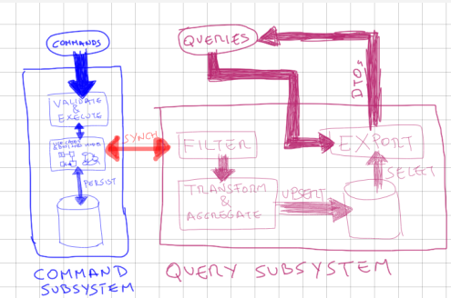
Data Managment (Database per service)
CQRS: Command Query Responsibility Segregation

Slide 21
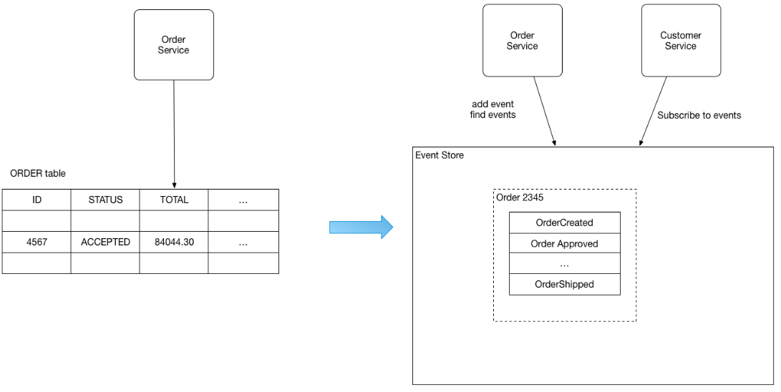
Data Managment (Database per service)
Event Sourcing

Slide 22
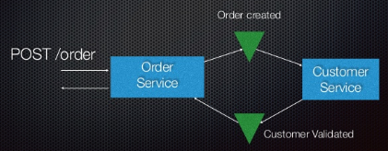
Anti-Pattern - Distribution is Free
Problem
Developers trat services as if they are programming language-level Modules (communicate via HTTP)
Consequences
High Latency
Synchronous communication
Solution
Consider Services Interact
Asynchrnous
Handle Synchronous Request without needing response from any other service
Replica of another services data

Slide 23
Anti-Pattern – Shared database
Problem
A database is accesed by multiple services
Consequences
Changing the database affects others services
Services are no insolated
Solution
Each table is only accessed by a single service
Services collaborate only through APIs

Slide 24
Anti-Pattern – (No technical)
Trying to fly before you can walk
Organization attempts microservices while lacking key skills (Automated testing, clean code, …)
Focusing on technology
Focus on infrastructure not application architecture
The more the merrier
Planning to have a large number of services
Red flag law
Adopting microservices without changing process, policies and organization

Slide 25
Tools

Slide 26
Tools
GitHub Access
Personal PCF Organization
Install IntelliJ
Lombok Plugin
Install jdk
Cliente GitHub
Install Gradle
Java 8

Slide 27
Links
https://github.ford.com/PCFDevEnablement
https://it2.spt.ford.com/sites/dev/SitePages/Home.aspx
https://dev-services.apps.pd01i.edc1.cf.ford.com/on-boarding
https://dcs.apps-pcf04v2i.cf.ford.com/
https://github.ford.com/DevEnablement/pcfdev-guides

Slide 28
Próximas sesiones

